Slide 1

Note
The data link layer is responsible for moving
frames from one hop (node) to the next.
2.<number>

Slide 2

Figure 2.6 Data link layer
2.<number>

Slide 3

Figure 2.7 Hop-to-hop delivery
2.<number>

Slide 4

Chapter 11
Data Link Control
11.<number>

Slide 5
Data Link Layer
The Data Link Layer is divided into two sublayers:
Data-link control
MAC sublayer
Data Link Control sublayer deals with :
Framing
Flow and Error Control
11.<number>

Slide 6
DLC Services
The data link layer needs to pack bits into frames, so that each frame is distinguishable from another.
Why whole message is not packed into a single frame?
Frame Size can be :
Fixed or Variable
In Fixed Frame size there is no need of defining the boundaries of the frame. The frame size itself is a delimiter.
11.<number>

Slide 7
Variable Frame Size
In Variable-size framing, we need a way to define the end of one frame and the beginning of the next.
Character Oriented Approach
Bit Oriented Approach
there are two types of network links:
point-to-point links : A point-to-point link consists of a single sender at one end of the link and a single
receiver at the other end of the link.
Many link-layer protocols have been designed for point-to-point links; the point-to-point protocol (PPP) and high-level data link control (HDLC) are two such protocols. And
a broadcast link, can have multiple sending and receiving nodes all connected to the same, single, shared broadcast channel.
11.<number>

Slide 8
Variable Frame Size
In Character(Byte)-Oriented Framing , data to be carried are 8-bit characters from a coding system such as ASCII.
Even the header and Trailer are multiple of 8 bits.
To separate one frame from the next , an 8 bits(1-byte) flag is added at the beginning and the end of a frame.
The flag is a protocol-dependent special characters.
Drawback: The flag could be selected to be any character not used for text communication.
But in case of graphs, audio and video : any character used for the flag could be part of the information
11.<number>

Slide 9

Figure 11.1 A frame in a character-oriented protocol
11.<number>

Slide 10
Byte-stuffing
In byte(character)-stuffing, a special byte is added to the data section of the frame when there is a character with the same pattern as the flag.
The data section is stuffed with an extra byte.
This extra-byte is called the escape character (ESC) and has a pre-defined bit pattern
11.<number>

Slide 11

Figure 11.2 Byte stuffing and unstuffing
11.<number>

Slide 12
Note
Byte stuffing is the process of adding 1 extra byte whenever there is a flag or escape character in the text.
11.<number>

Slide 13
Bit-oriented Approach
In Bit-Oriented framing, the data section of a frame is a sequence of bits to be interpreted by the upper layer as text, audio or video etc.
Most protocols use a special 8-bit pattern flag, 01111110 as the delimiter to define the beginning and the end of the frame.
11.<number>

Slide 14

Figure 11.3 A frame in a bit-oriented protocol
11.<number>

Slide 15
Note
Bit stuffing is the process of adding one extra 0 whenever five consecutive 1s follow a 0 in the data, so that the receiver does not mistake
the pattern 0111110 for a flag.
11.<number>

Slide 16
Bit-Stuffing
This flag(01111110) can create the same type of problem as the character-oriented protocols.
So if the flag pattern appears in the data, the receiver is informed that this is not the end of frame.
This can be done by stuffing 1 single bit (instead of 1 byte) to prevent the pattern from looking like a flag.
This is bit-stuffing.
In bit-stuffing, if a 0 and five consecutive 1 bits are encountered, an extra 0 is added.
At the receiver side, this extra bit removed from data .
11.<number>

Slide 17

Figure 11.4 Bit stuffing and unstuffing
11.<number>

Slide 18
Note
Error control in the data link layer is based on automatic repeat request, which is the retransmission of data.
11.<number>

Slide 19
11-3 PROTOCOLS
The data link layer combines framing, flow control, and error control to achieve the delivery of data from one node to another.
The protocols are normally implemented in software by using one of the common programming languages.
11.<number>

Slide 20
11-3 Flow- Control
One of the several ways is to use two buffers , one at the sender’ s side and one at the receiver’s side.
When the buffer of the receiving data link layer is full, it informs the sending data link layer to stop pushing frames.
11.<number>

Slide 21
11-3 Error Control
In both methods, a CRC is added to the frame tail by the sender and checked by the receiver.
If the frame is corrupted , it is silently discarded ; if it not corrupted the packet is delivered to the network layer.
If a frame is corrupted it is silently discarded ; if it is not corrupted an acknowledgement is sent (for the purpose of both flow and error control) to the sender.
11.<number>

Slide 22
11-3 Combination of Flow and Error Control
Flow and error control can be combined .
In a simple situation , an acknowledgment that is sent for flow control can also be used for error control to tell the sender that the packet has arrived uncorrupted.
The lack of acknowledgement means that there is a problem in the sent frame.
11.<number>

Slide 23
11-3 Connectionless and Connection-Oriented
In a connectionless protocol, a frames are sent from one node to the next without any relationship between the frames ; each frame is independent.
Here Connectionless means that there is no connection between frames. The frames are not numbered and there is no sense of ordering.
Most of the data link protocols for LANs are connectionless protocols.
11.<number>

Slide 24
11-3 Connection-Oriented Protocol
In a Connection-Oriented protocol, first a logical connection is established between the two nodes (setup phase).
After all frames that are somehow related to each other are transmitted (transfer phase).
At last , the logical connection is terminated (teardown phase).
In this type of communication, the frames are numbered and sent in order.
If they are not received in order, the receiver needs to wait until all frames belonging to the same set are received and then deliver them in order to the network layer.
Connection-oriented protocols are rare in wired LANs.
But can be seen in some point-to-point protocols , some wireless LAN and some WAN
11.<number>

Slide 25

Figure 11.5 Taxonomy of protocols discussed in this chapter
11.<number>

Slide 26
11-4 NOISELESS CHANNELS
Let us first assume we have an ideal channel in which no frames are lost, duplicated, or corrupted. We introduce two protocols for this type of channel.
Topics discussed in this section:
Simplest Protocol
Stop-and-Wait Protocol
11.<number>

Slide 27

Figure 11.6 The design of the simplest protocol with no flow or error control
11.<number>

Slide 28
Example 11.1
Figure 11.7 (next slide) shows an example of communication using this protocol.
It is very simple.
The sender sends a sequence of frames without even thinking about the receiver.
To send three frames, three events occur at the sender site and three events at the receiver site.
Note that the data frames are shown by tilted boxes; the height of the box defines the transmission time difference between the first bit and the last bit in the frame.
11.<number>

Slide 29

Figure 11.7 Flow diagram for Example 11.1
11.<number>

Slide 30

Figure 11.8 Design of Stop-and-Wait Protocol
11.<number>

Slide 31
Example 11.2
Figure 11.9 (next slide) shows an example of communication using this protocol.
It is still very simple.
The sender sends one frame and waits for feedback from the receiver.
When the ACK arrives, the sender sends the next frame.
Note that sending two frames in the protocol involves the sender in four events and the receiver in two events.
11.<number>

Slide 32

Figure 11.9 Flow diagram for Example 11.2
11.<number>

Slide 33
11-5 NOISY CHANNELS
Although the Stop-and-Wait Protocol gives us an idea of how to add flow control to its predecessor, noiseless channels are nonexistent. We discuss three protocols in this section that use error control.
Topics discussed in this section:
Stop-and-Wait Automatic Repeat Request
Go-Back-N Automatic Repeat Request
Selective Repeat Automatic Repeat Request
11.<number>

Slide 34

Figure 11.10 Design of the Stop-and-Wait ARQ Protocol
11.<number>

Slide 35
Example 11.3
Figure 11.11 shows an example of Stop-and-Wait ARQ.
Frame 0 is sent and acknowledged.
Frame 1 is lost and resent after the time-out.
The resent frame 1 is acknowledged and the timer stops. Frame 0 is sent and acknowledged, but the acknowledgment is lost.
The sender has no idea if the frame or the acknowledgment is lost, so after the time-out, it resends frame 0, which is acknowledged.
11.<number>

Slide 36

Figure 11.11 Flow diagram for Example 11.3
11.<number>

Slide 37
11-6 HDLC (High-level Data Link Control)
(HDLC) is a bit-oriented protocol for communication over point-to-point and multipoint links.
It implements Stop-and-Wait protocol.
It forms a basis for other practical protocols such as PPP.
Topics discussed in this section:
Configurations and Transfer Modes
Frames
Control Field
11.<number>

Slide 38
11-6 HDLC (High-level Data Link Control)
HDLC provides two common transfer modes:
1. Normal response Mode:
In NRM, A primary station can send commands, a secondary station can only response.
The NRM is used for both point-to-point and multi-point links
2. Asynchronous balanced Mode:
In ABM , the configuration is balanced . The link is point-to-point and each station can function as primary and a secondary (acting as peers).
This the common mode today.
11.<number>

Slide 39
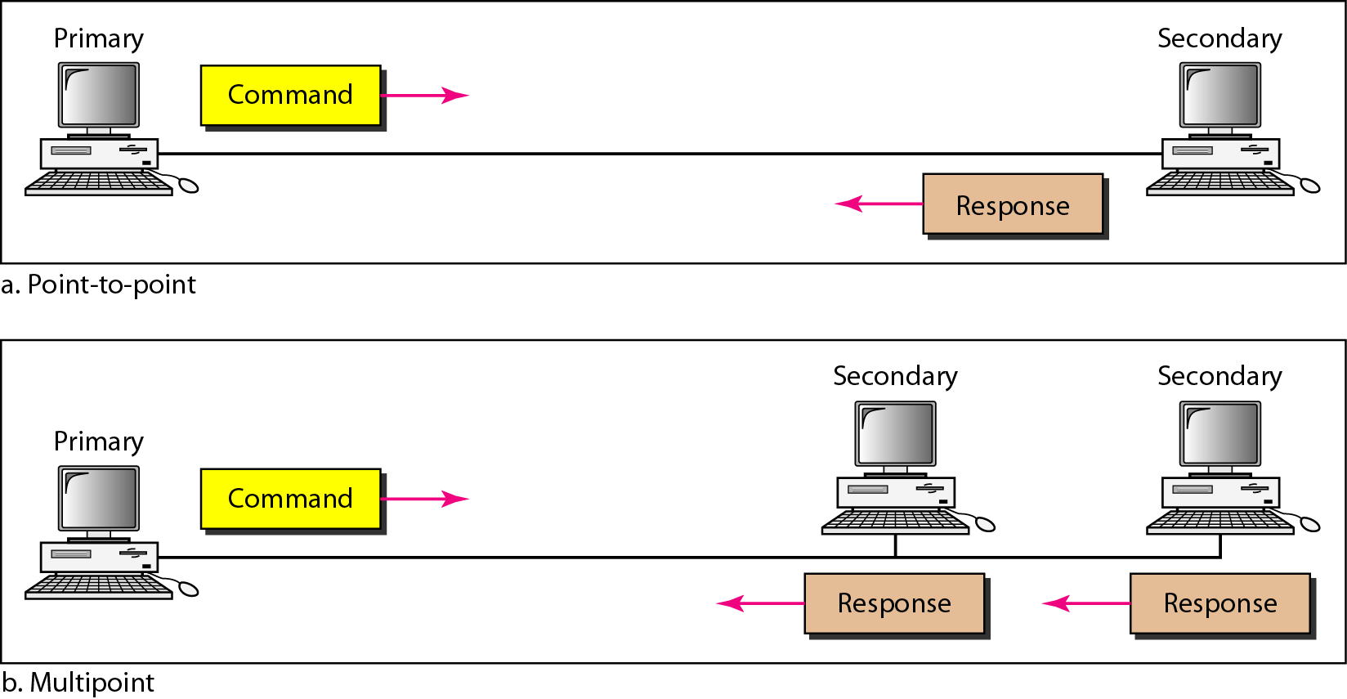
Figure 11.25 Normal response mode
11.<number>

Slide 40
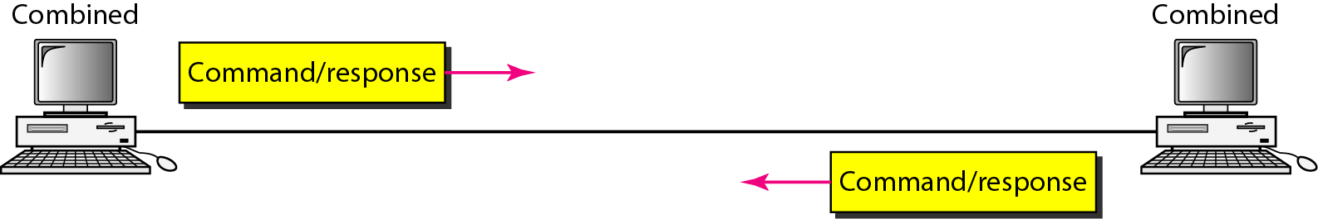
Figure 11.26 Asynchronous balanced mode
11.<number>

Slide 41
Framing of HDLC protocol
HDLC defines three types of frames:
1. Information Frame (I-frame)
2. Supervisory Frame (S-frame)
3. unnumbered Frame (U-frame)
1. I-frames are used to data –link user data and control information .
2. S-frames are used for only to transport control information.
3. U-frames are reserved for system management. (link managment)
11.<number>

Slide 42
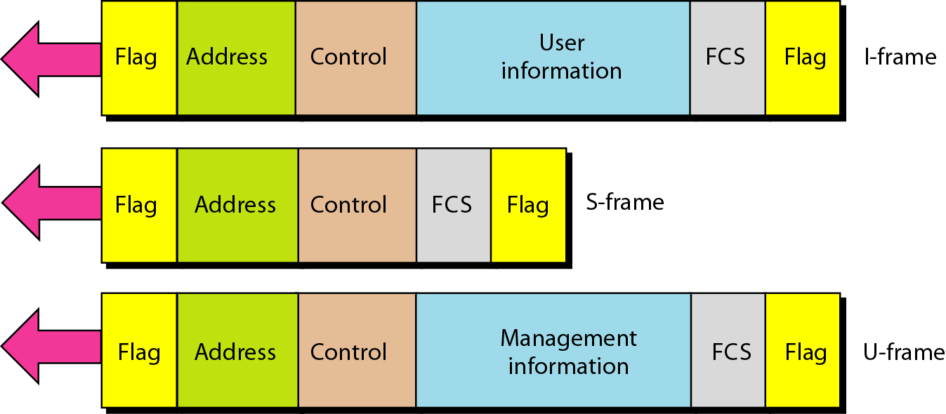
Figure 11.27 HDLC frames
11.<number>

Slide 43
Framing of HDLC protocol
Each frame in HDLC may contain up to six fields:
1. Beginning flag field:
it contains synchronous pattern 01111110 for identifying the beginning and end of the field.
2. Address field: it contains the address of the secondary station. If a primary station created the , it contains to address. If a secondary station creates the frame, it contains a from address. The address can be one byte or several bytes long depending on the need of network.
3. Control field:
It is one or two byte used for flow and error control.
4. Information field: it contains either user’s data from network layer or management information. Its length can vary from one network to another.
5.Frame Check Sequence: it can contains either 2- or 4- byte CRC for error detection .
6.Ending flag field
11.<number>

Slide 44
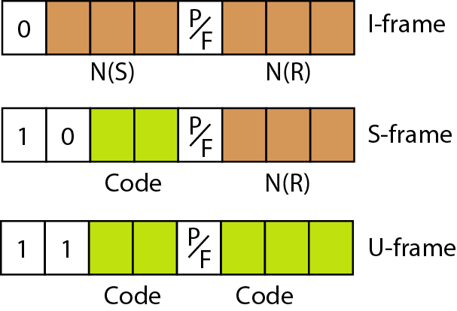
Figure 11.28 Control field format for the different frame types
11.<number>

Slide 45
Control Field for I-frame
I-frame can be used carrying user’s data or flow and error control information.
The subfields in the control field are used to define these function:
1. If the first bit the control field is 0,it means it an I-frame.
The next 3-bit (N(s)) define sequence of the frame (0….7).
The last 3-bits (N(R)) correspond to the acknowledgement number when piggybacking is used.
The P/F field has meaning only when it is set (bit=1) and can mean poll or final.
It means poll when a frame is send
11.<number>

Slide 46
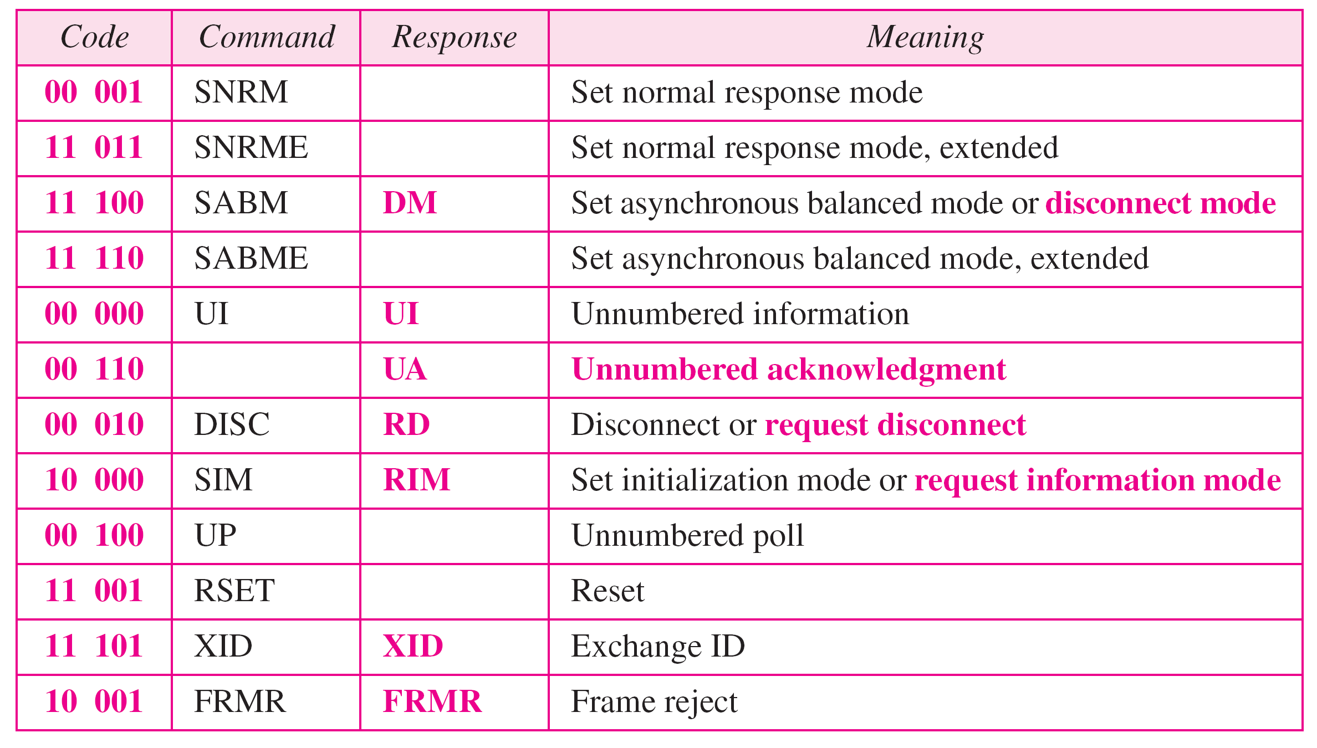
Table 11.1 U-frame control command and response
11.<number>

Slide 47
Example 11.9
U-frames can be used for connection establishment and connection release.
Node A asks for a connection with a set asynchronous balanced mode (SABM) frame; node B gives a positive response with an unnumbered acknowledgment (UA) frame.
After these two exchanges, data can be transferred between the two nodes (not shown in the figure).
After data transfer, node A sends a DISC (disconnect) frame to release the connection; it is confirmed by node B responding with a UA (unnumbered acknowledgment).
11.<number>

Slide 48
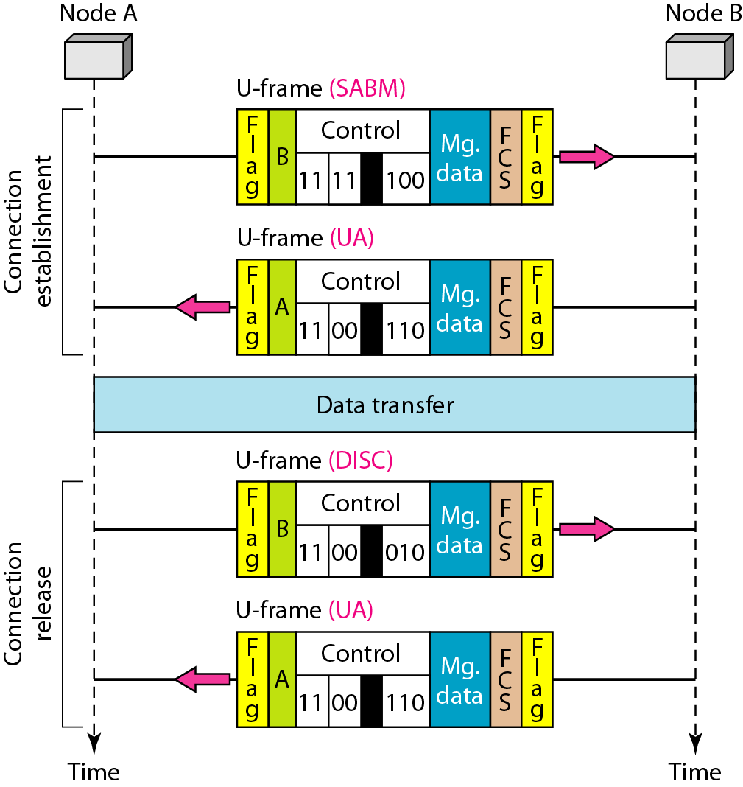
Figure 11.29 Example of connection and disconnection
11.<number>

Slide 49
Example 11.10
Figure 11.30 shows an exchange using piggybacking. Node A begins the exchange of information with an
I-frame numbered 0 followed by another I-frame numbered 1.
Node B piggybacks its acknowledgment of both frames onto an I-frame of its own.
Node B’s first
I-frame is also numbered 0 [N(S) field] and contains a 2 in its N(R) field, acknowledging the receipt of A’s frames 1 and 0 and indicating that it expects frame 2 to arrive next. Node B transmits its second and third I-frames (numbered 1 and 2) before accepting further frames from node A.
11.<number>

Slide 50
Example 11.10 (continued)
Its N(R) information, therefore, has not changed:
B frames 1 and 2 indicate that node B is still expecting A’s frame 2 to arrive next.
Node A has sent all its data. Therefore, it cannot piggyback an acknowledgment onto an I-frame and sends an S-frame instead.
The RR code indicates that A is still ready to receive.
The number 3 in the N(R) field tells B that frames 0, 1, and 2 have all been accepted and that A is now expecting frame number 3.
11.<number>

Slide 51
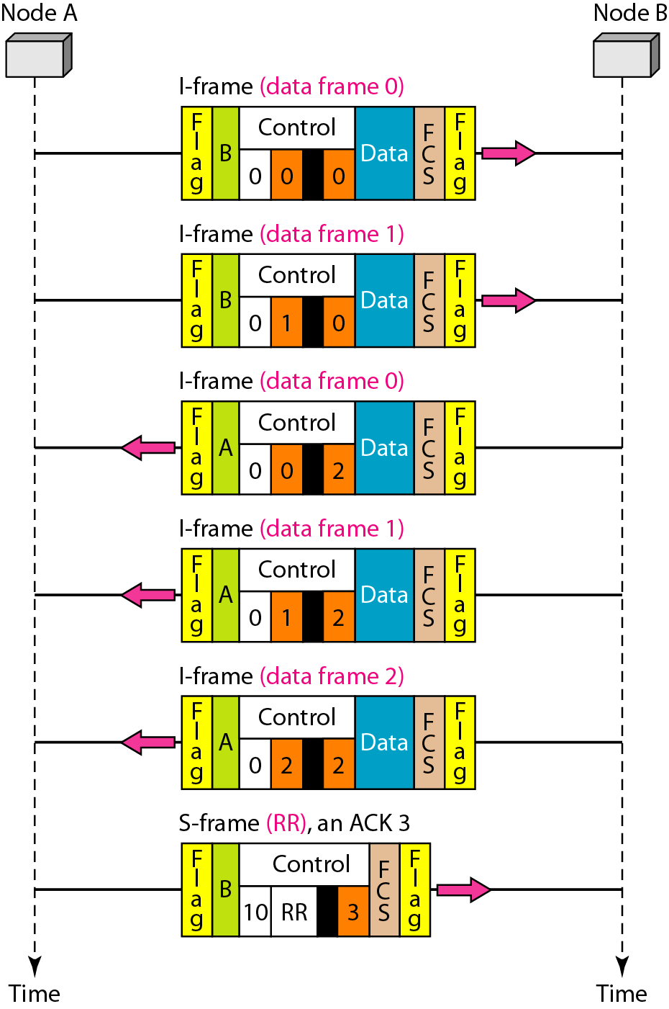
Figure 11.30 Example of piggybacking without error
11.<number>

Slide 52
Example 11.11
Figure 11.31 shows an exchange in which a frame is lost.
Node B sends three data frames (0, 1, and 2), but frame 1 is lost.
When node A receives frame 2, it discards it and sends a REJ frame for frame 1.
Note that the protocol being used is Go-Back-N with the special use of an REJ frame as a NAK frame.
The NAK frame does two things here:
It confirms the receipt of frame 0 and declares that frame 1 and any following frames must be resent.
Node B, after receiving the REJ frame, resends frames 1 and 2.
Node A acknowledges the receipt by sending an RR frame (ACK) with acknowledgment number 3.
11.<number>

Slide 53
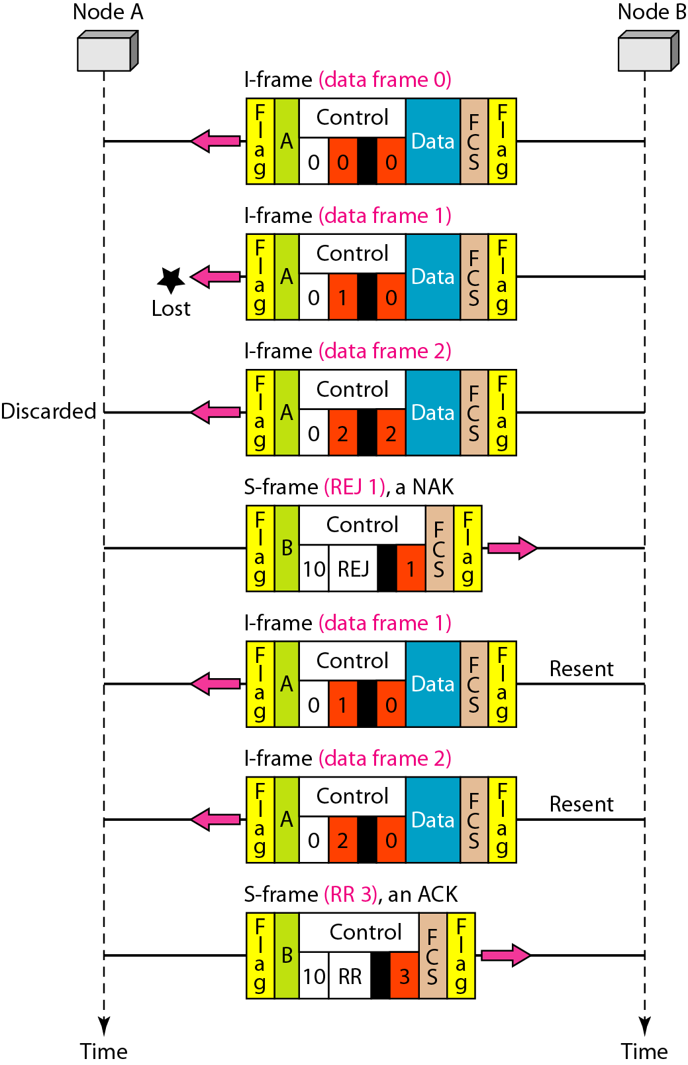
Figure 11.31 Example of piggybacking with error
11.<number>

Slide 54
11-7 POINT-TO-POINT PROTOCOL
Although HDLC is a general protocol that can be used for both point-to-point and multipoint configurations, one of the most common protocols for point-to-point access is the Point-to-Point Protocol (PPP). PPP is a byte-oriented protocol.
Topics discussed in this section:
Framing
Transition Phases
Multiplexing
Multilink PPP
11.<number>

Slide 55
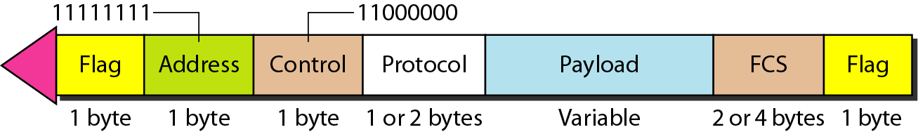
Figure 11.32 PPP frame format
11.<number>

Slide 56
Note
PPP is a byte-oriented protocol using byte stuffing with the escape byte 01111101.
11.<number>

Slide 57
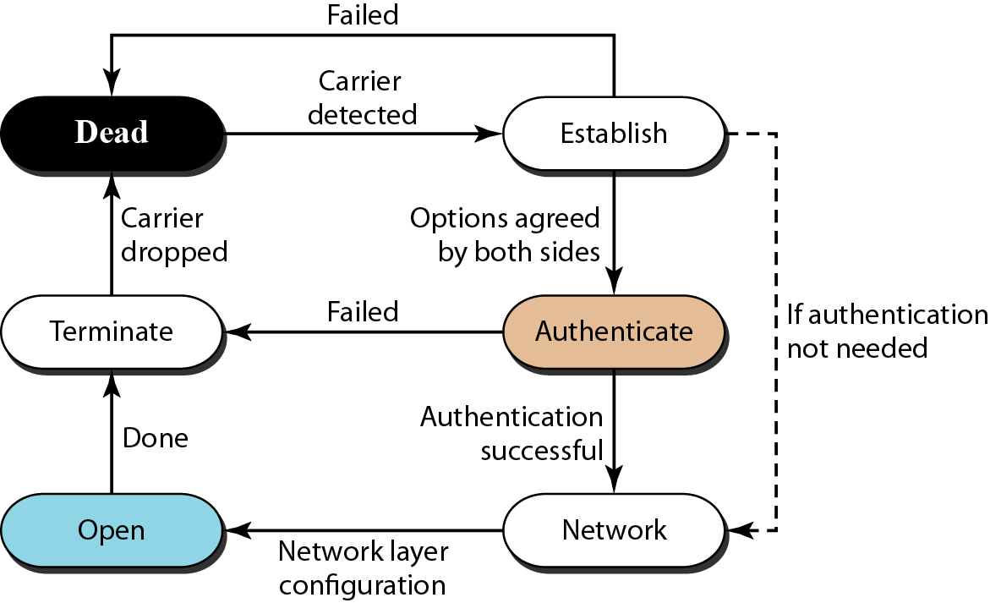
Figure 11.33 Transition phases
11.<number>

Slide 58
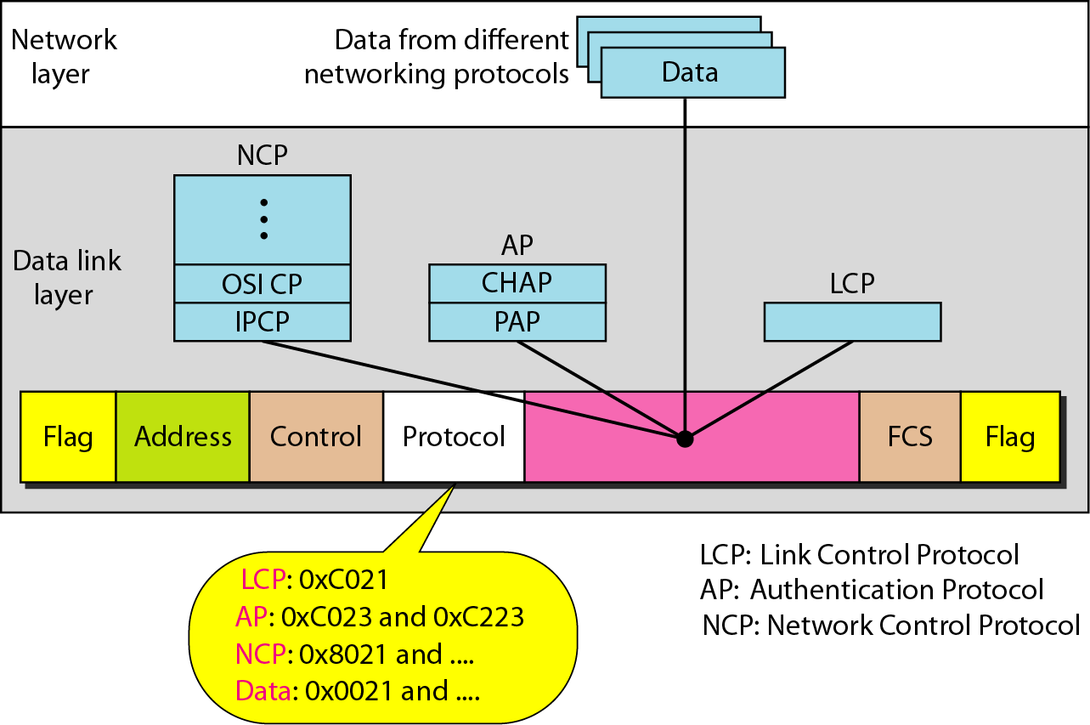
Figure 11.34 Multiplexing in PPP
11.<number>

Slide 59
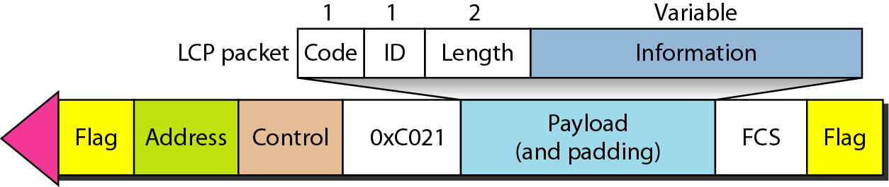
Figure 11.35 LCP packet encapsulated in a frame
11.<number>

Slide 60
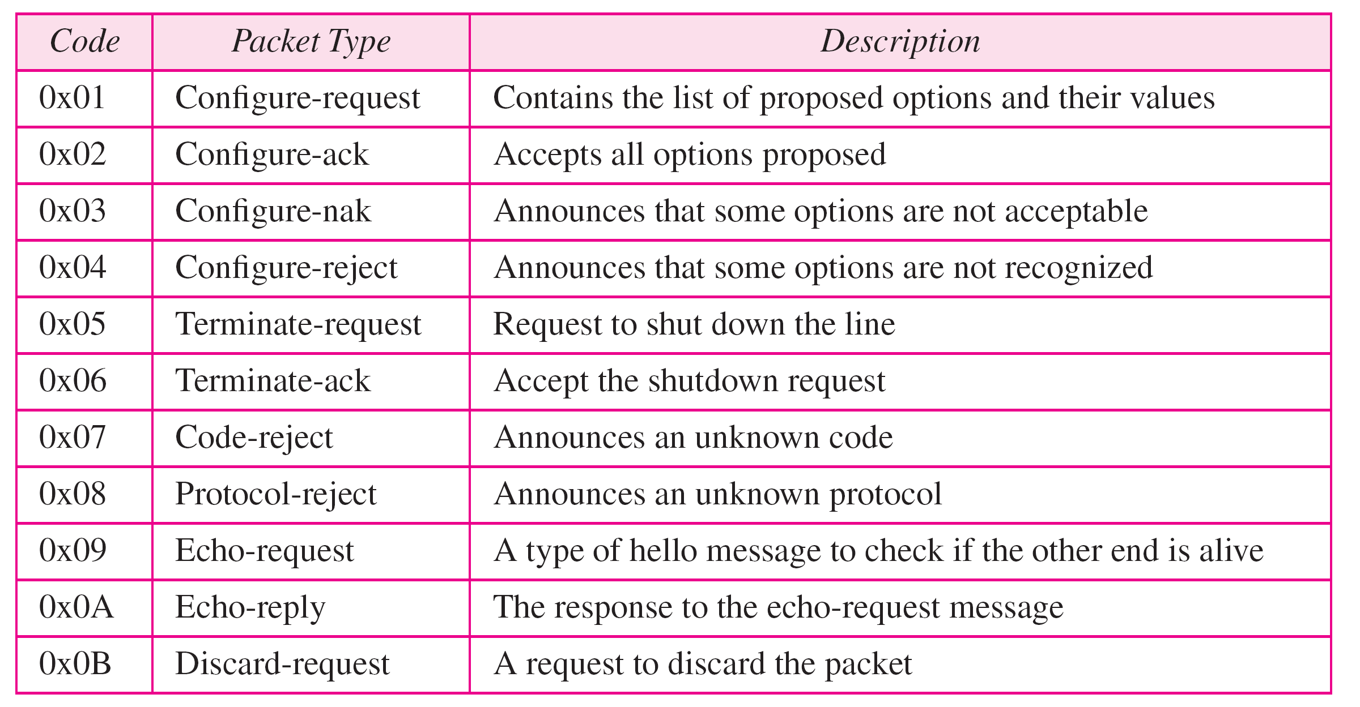
Table 11.2 LCP packets
11.<number>

Slide 61
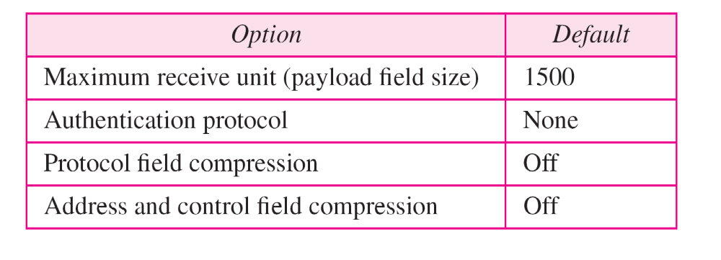
Table 11.3 Common options
11.<number>

Slide 62
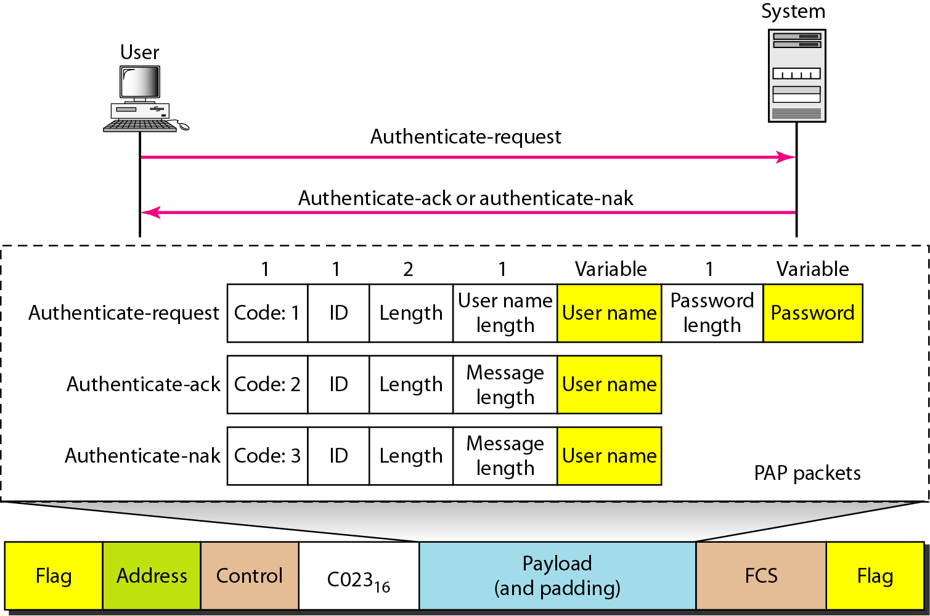
Figure 11.36 PAP packets encapsulated in a PPP frame
11.<number>

Slide 63
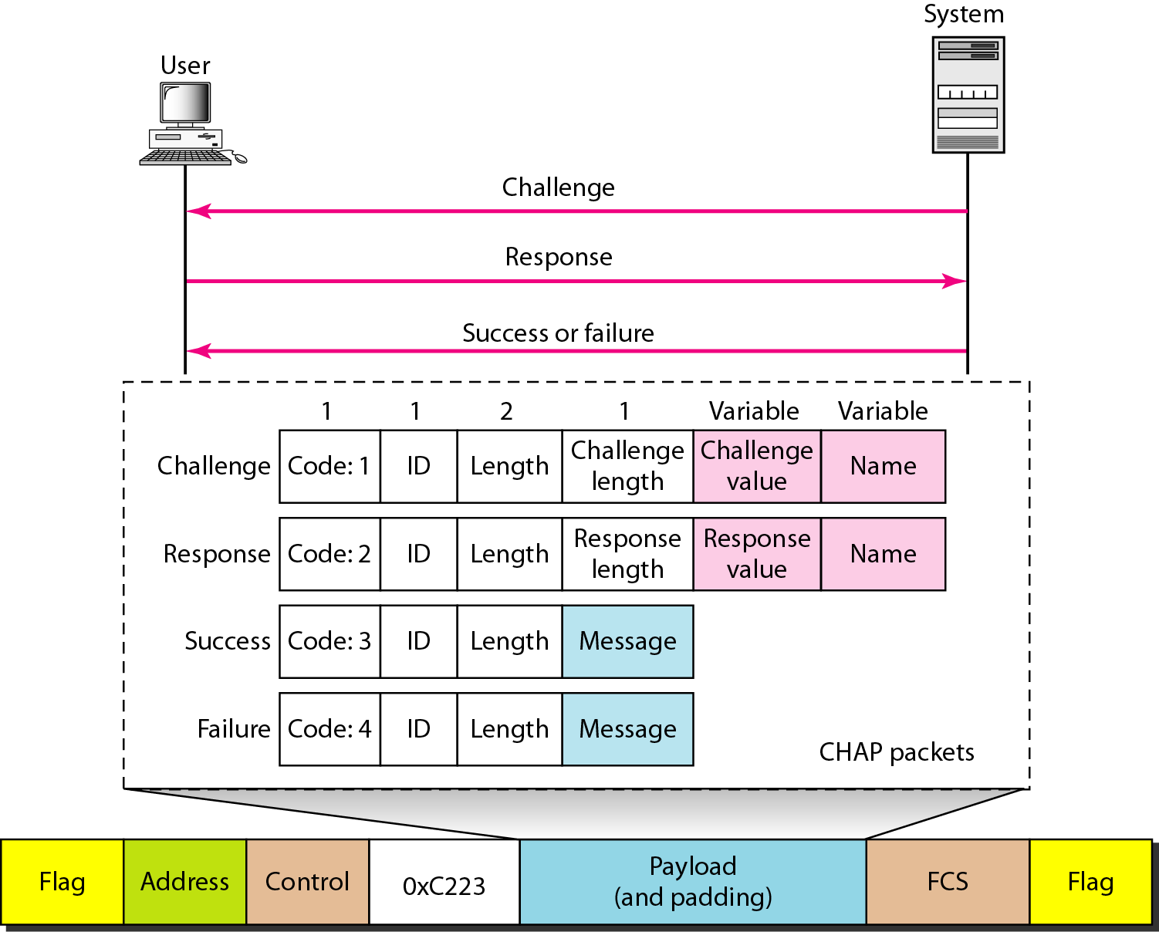
Figure 11.37 CHAP packets encapsulated in a PPP frame
11.<number>

Slide 64
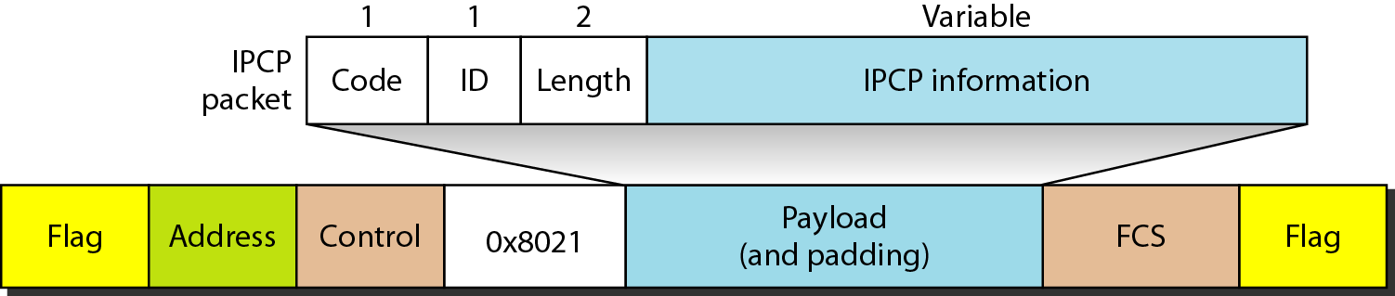
Figure 11.38 IPCP packet encapsulated in PPP frame
11.<number>

Slide 65
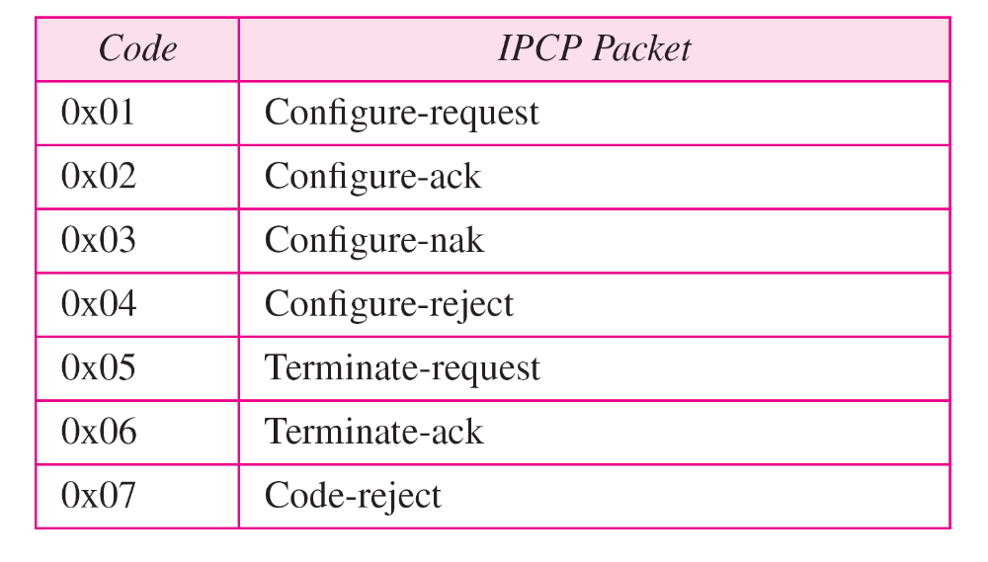
Table 11.4 Code value for IPCP packets
11.<number>

Slide 66
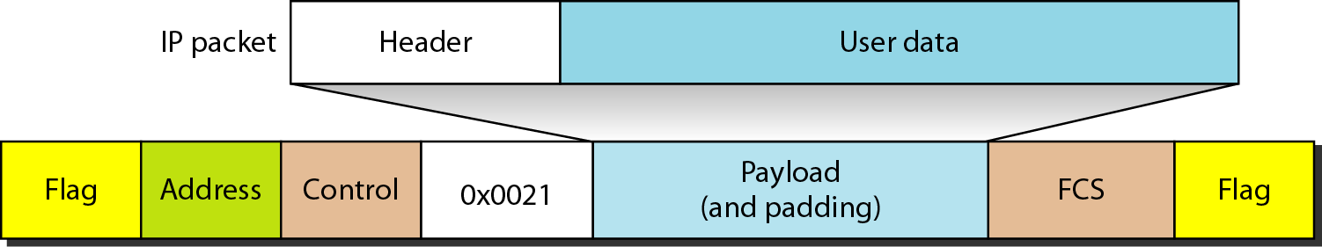
Figure 11.39 IP datagram encapsulated in a PPP frame
11.<number>

Slide 67
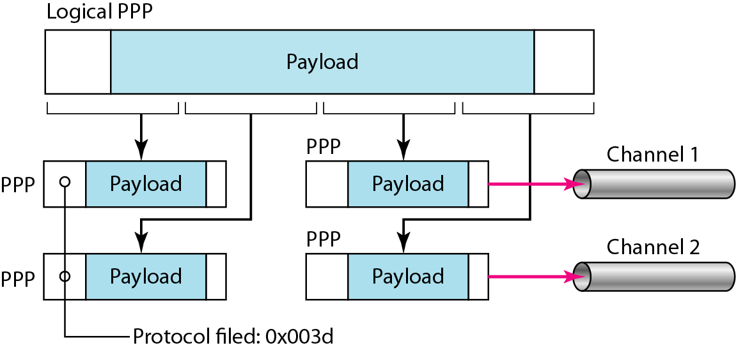
Figure 11.40 Multilink PPP
11.<number>

Slide 68
Example 11.12
Let us go through the phases followed by a network layer packet as it is transmitted through a PPP connection. Figure 11.41 shows the steps. For simplicity, we assume unidirectional movement of data from the user site to the system site (such as sending an e-mail through an ISP).
The first two frames show link establishment. We have chosen two options (not shown in the figure): using PAP for authentication and suppressing the address control fields. Frames 3 and 4 are for authentication. Frames 5 and 6 establish the network layer connection using IPCP.
11.<number>

Slide 69
Example 11.12 (continued)
The next several frames show that some IP packets are encapsulated in the PPP frame. The system (receiver) may have been running several network layer protocols, but it knows that the incoming data must be delivered to the IP protocol because the NCP protocol used before the data transfer was IPCP.
After data transfer, the user then terminates the data link connection, which is acknowledged by the system. Of course the user or the system could have chosen to terminate the network layer IPCP and keep the data link layer running if it wanted to run another NCP protocol.
11.<number>

Slide 70
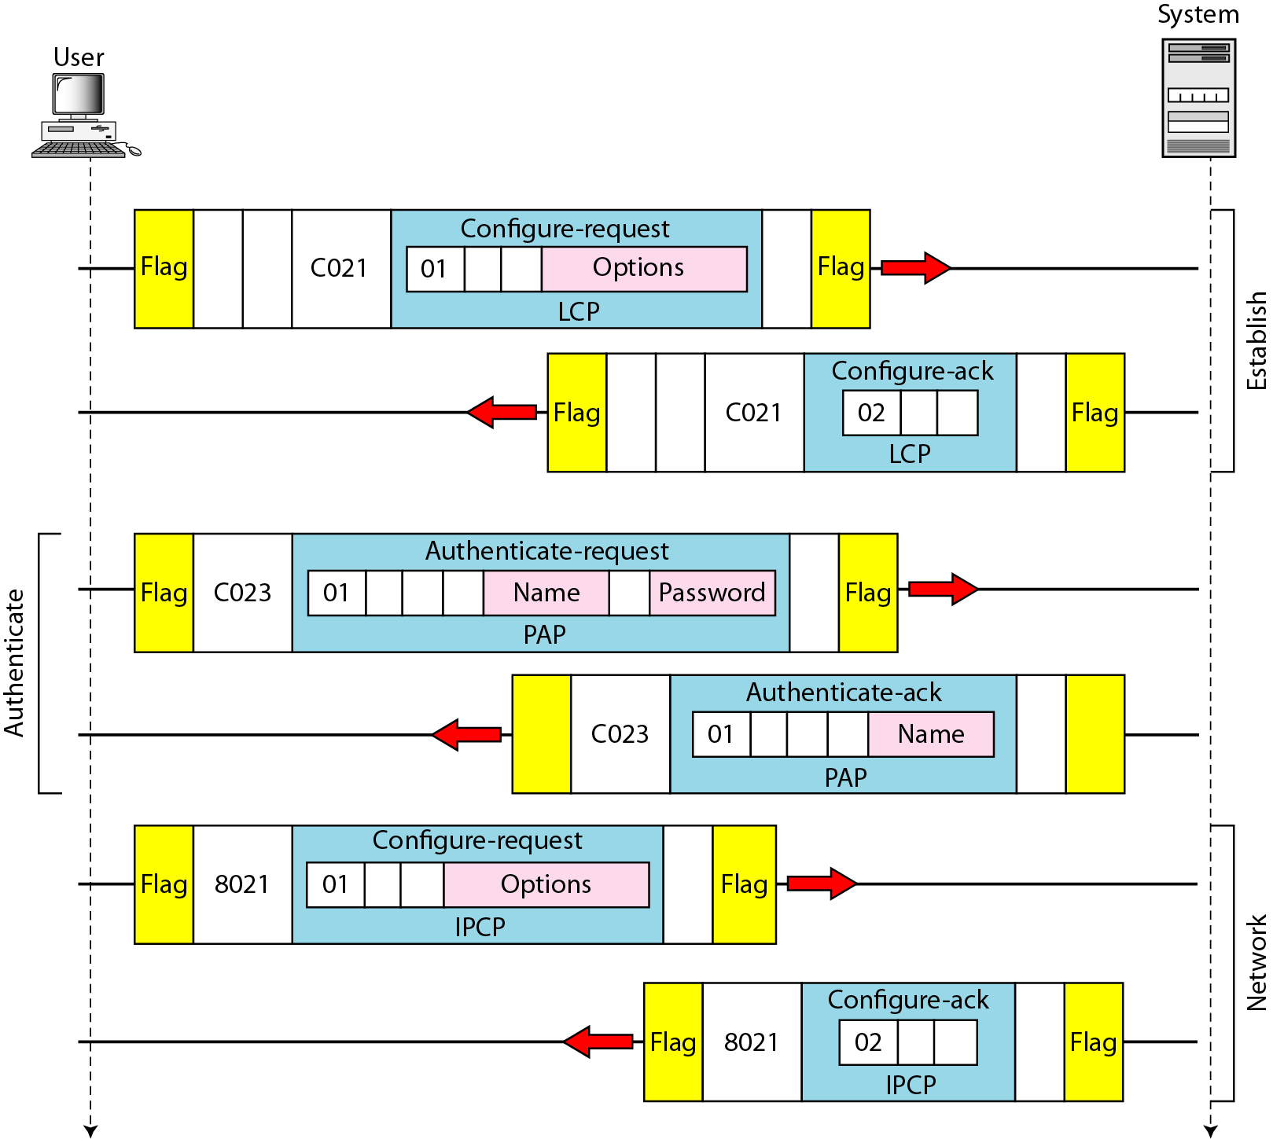
Figure 11.41 An example
11.<number>

Slide 71
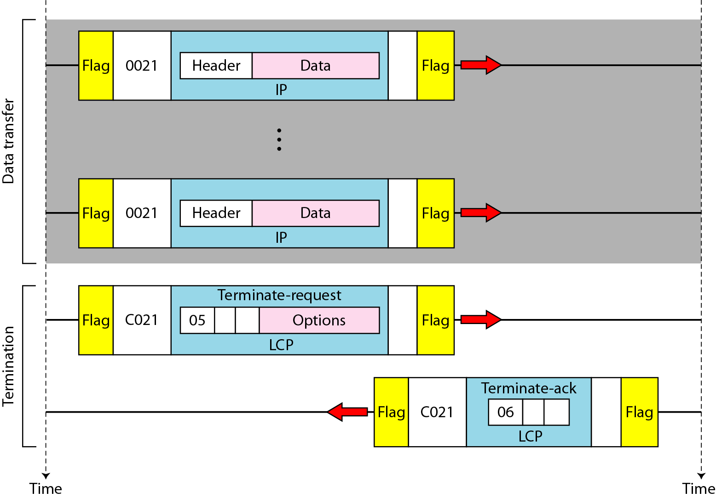
Figure 11.41 An example (continued)
11.<number>

Slide 72
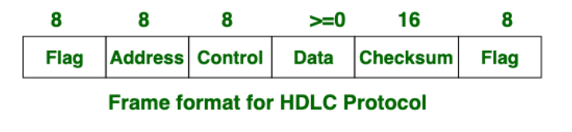
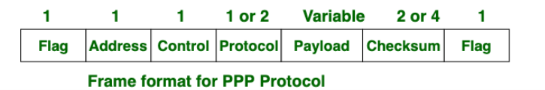
Comparison of HLDC and PPP protocols)
The main difference between High-level Data Link Control (HDLC) and Point-to-Point Protocol (PPP) is that High-level Data Link Control is the bit-oriented protocol, on the other hand, Point-to-Point Protocol is the byte-oriented protocol.
Another difference between HDLC and PPP is that HDLC is implemented by Point-to-point configuration and also multi-point configurations on the other hand While PPP is implemented by Point-to-Point configuration only.
11.<number>

Slide 73
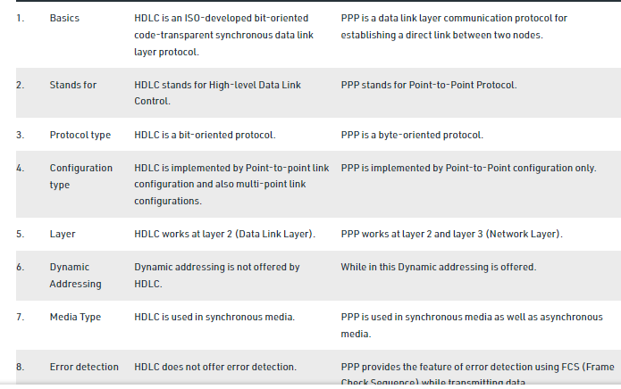
Comparison of HLDC and PPP protocols)
11.<number>

